Slide 1
UK Traffic Accidents
Plots & Analysis
By: Chan Xi Cecilia

Slide 2
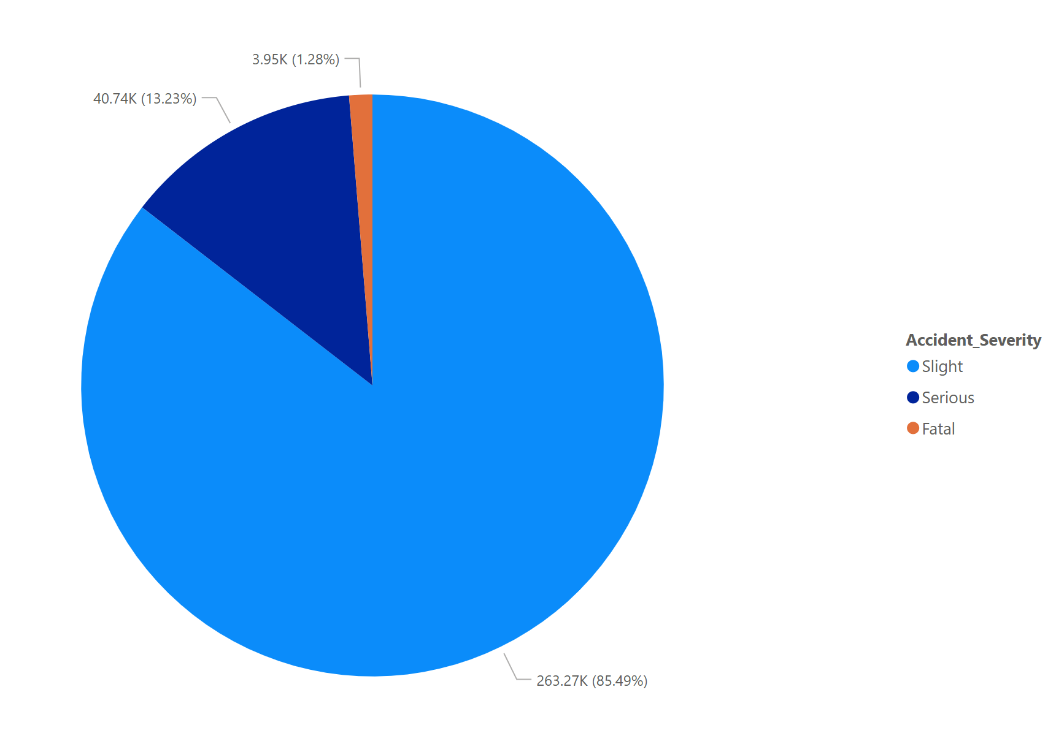
Distribution of Accident Severity
Majority is Slight (85.49%)
Fatal is the huge Minority (1.28%)
Most of the traffic accidents in UK are not too severe most of the time

Slide 3
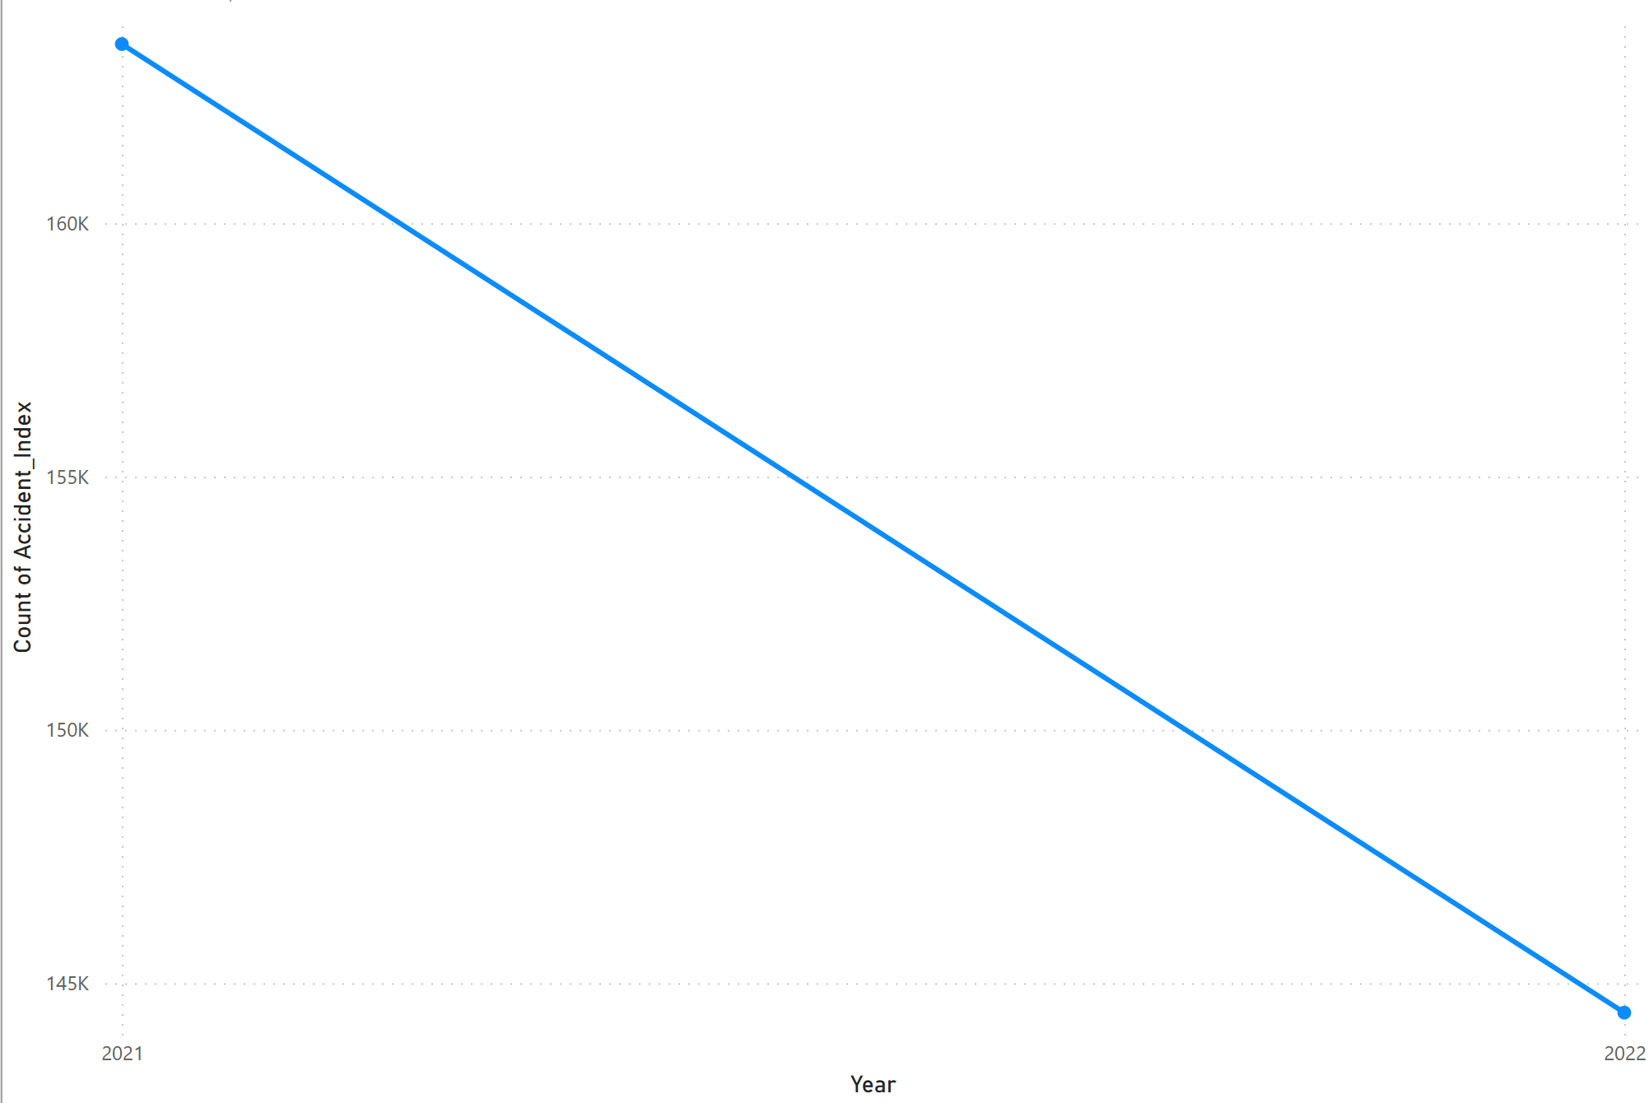
Number of Accidents over the Years
There is a huge decrease from 2021 – 2022
Could be
  Improved regulations
  More user caution
  Enforcement measures
  Etc

Slide 4
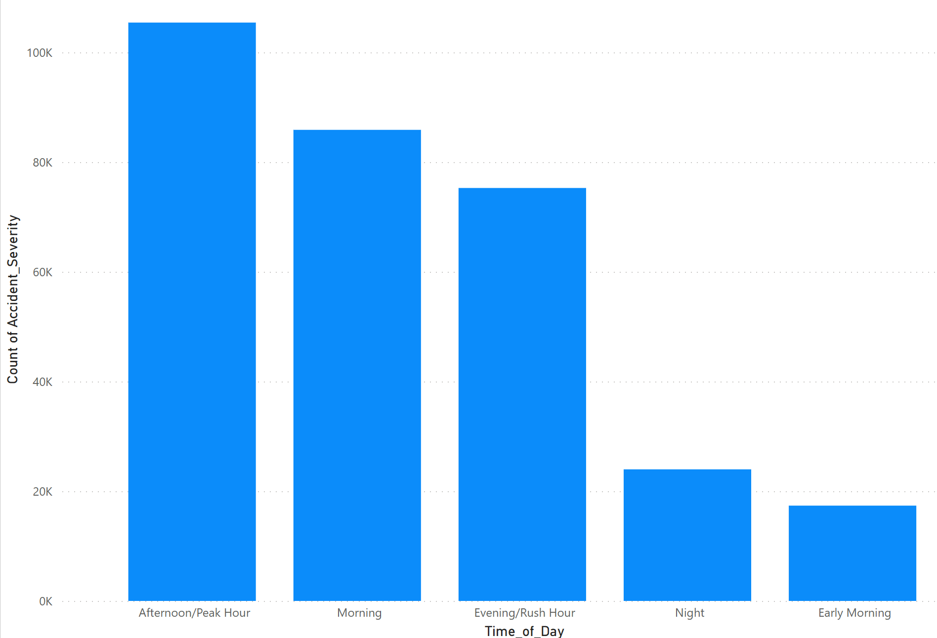
Number of Accidents over the Years
Most of the accidents occur during the Afternoon/Peak Hour followed by Morning & Evening/Rush Hour
  Many people going to work, lunch and home
    Traffic congestions
      Higher risk of traffic accidents happening

Slide 5
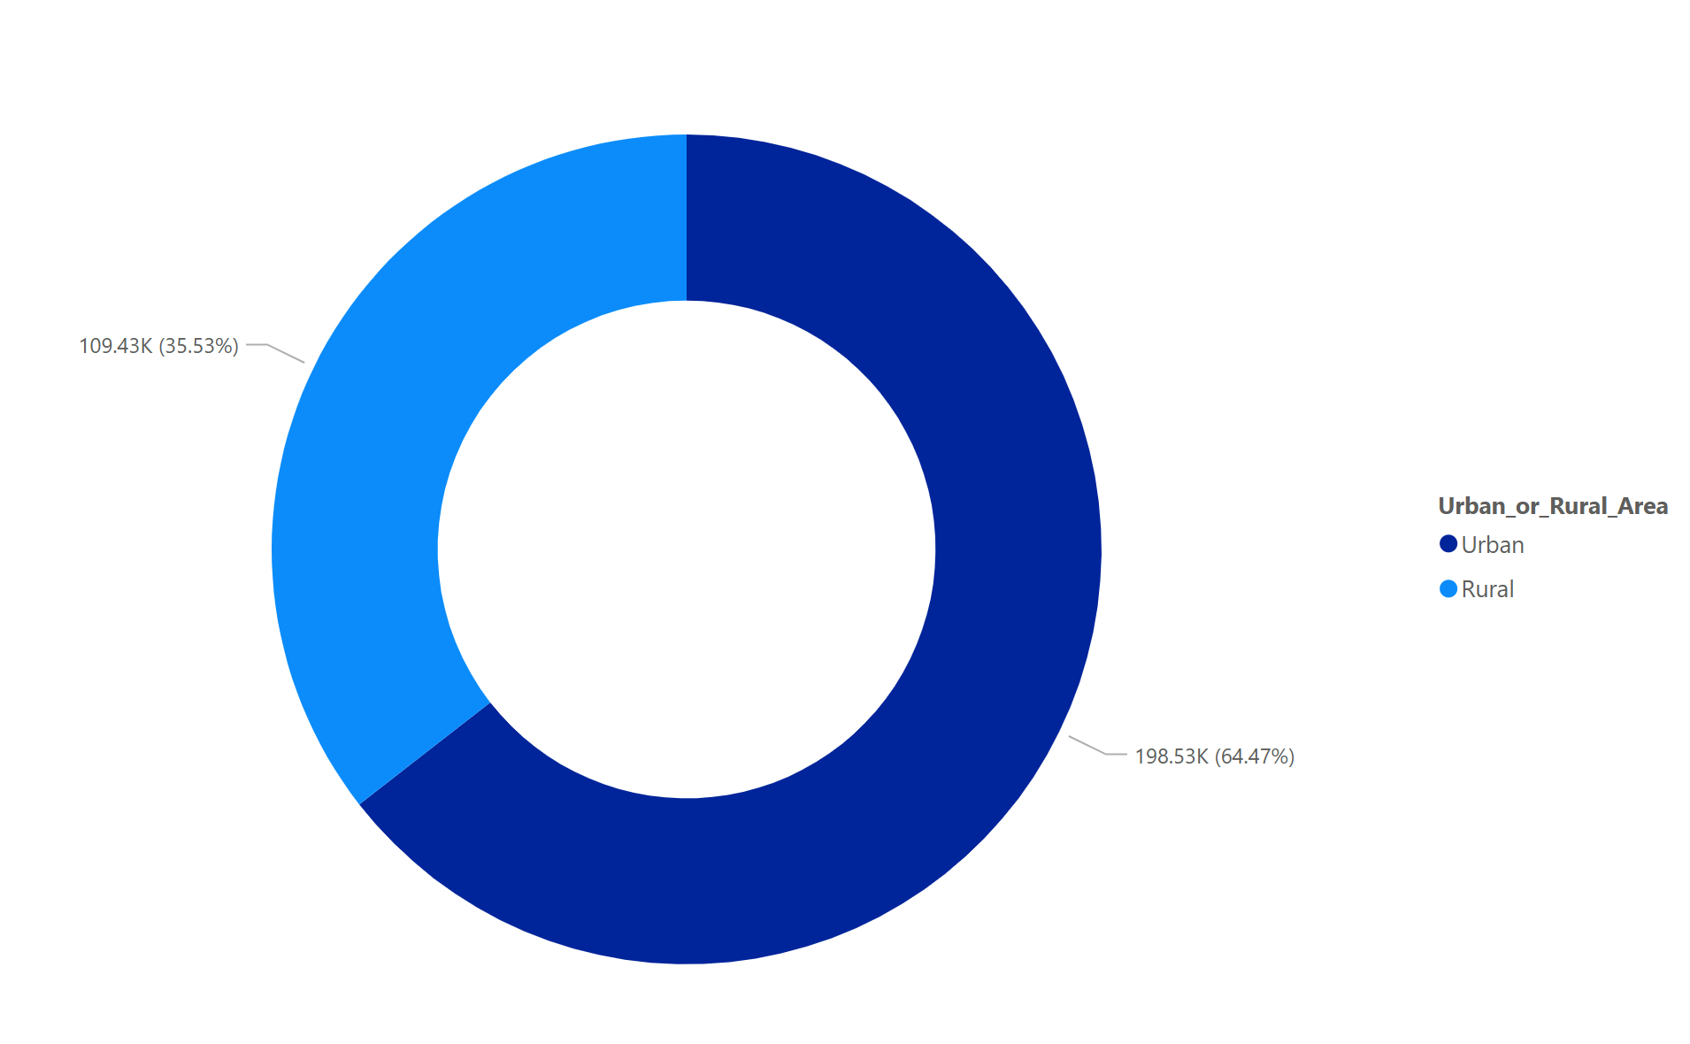
Proportion of Accidents in Urban/Rural Areas
Majority of accidents happen in Urban Areas (64.47%)
  High Population → More vehicles on the road → Traffic congestion → Higher risk of traffic accidents

Slide 6
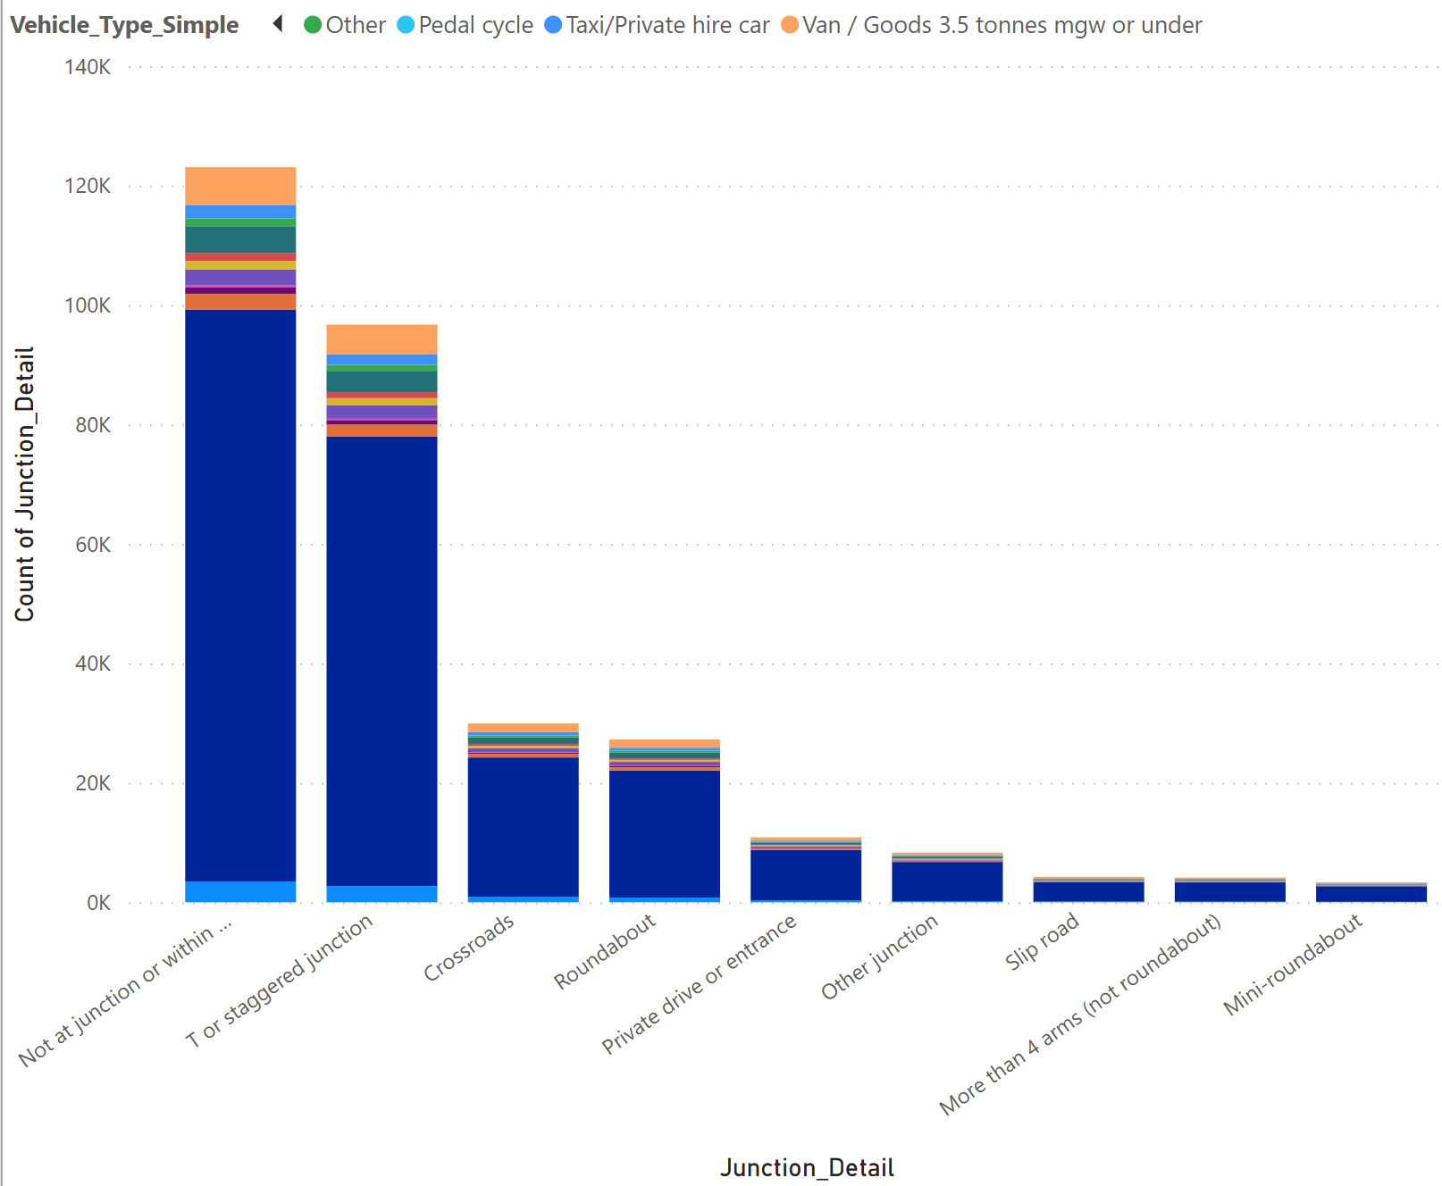
Number of Accidents of different Vehicle types at each Junction
Most accidents involved cars
  A vehicle type owned by a mast majority
Most of the accidents occurs in areas
  Not at junction or within 20 meters
  T or Staggered junction

Slide 7
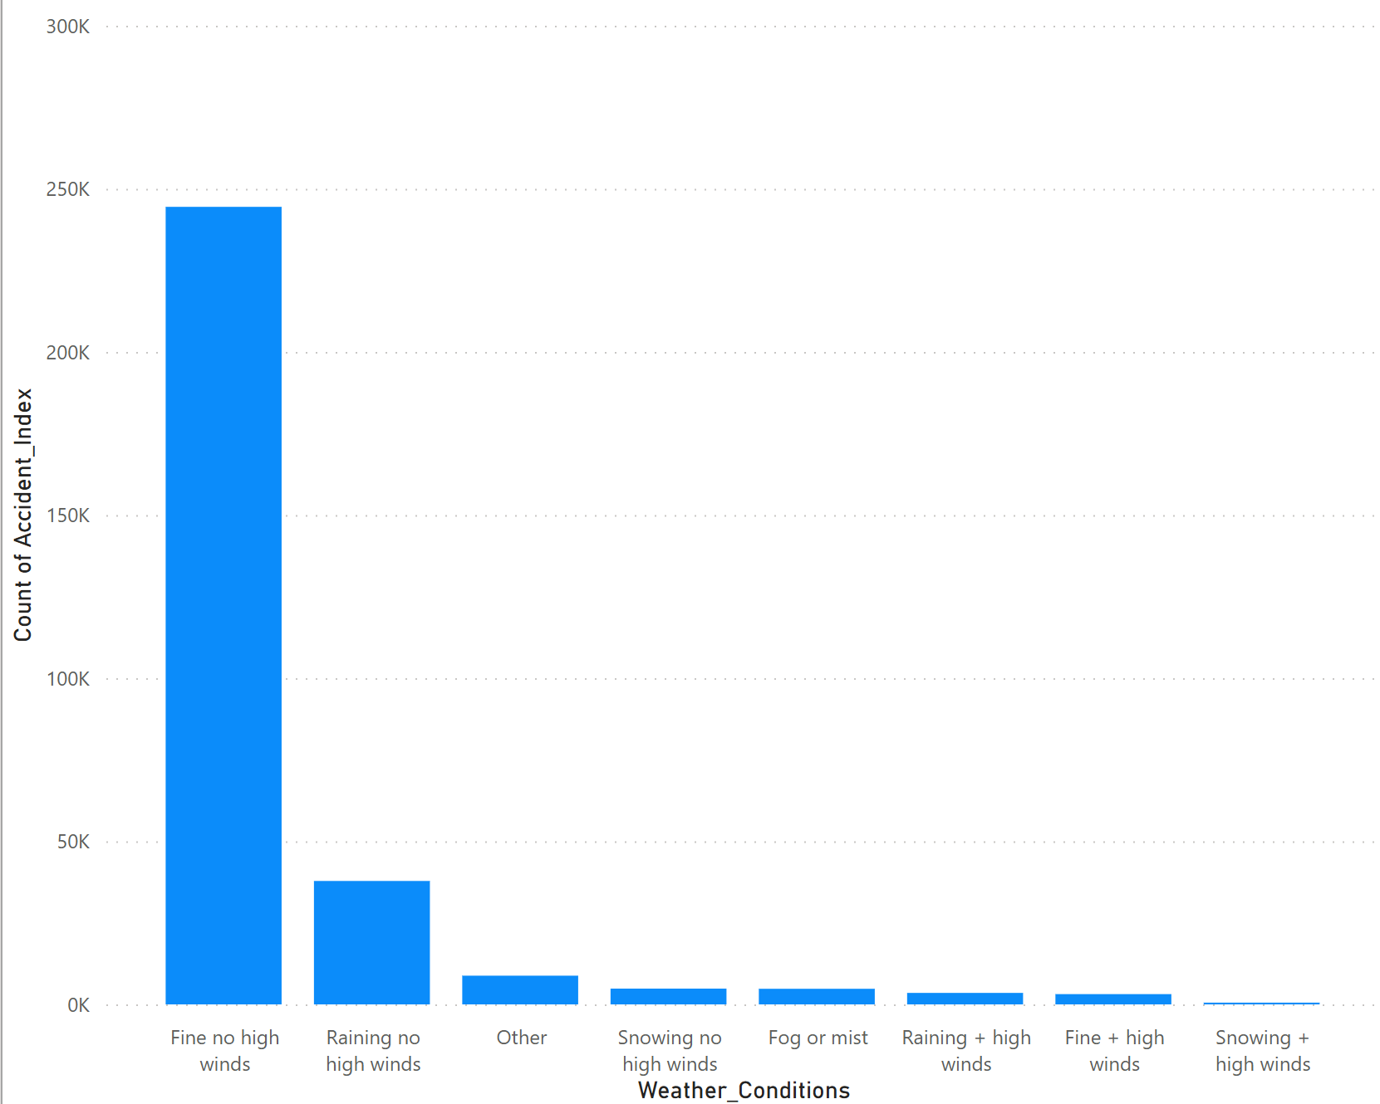
Number of Accidents by Weather Conditions
Most accidents seem to occur in good weather
  Draws more vehicles on the road
  Characteristics of good weather (E.g., high visibility) can lead to negative commuter behavior

Slide 8
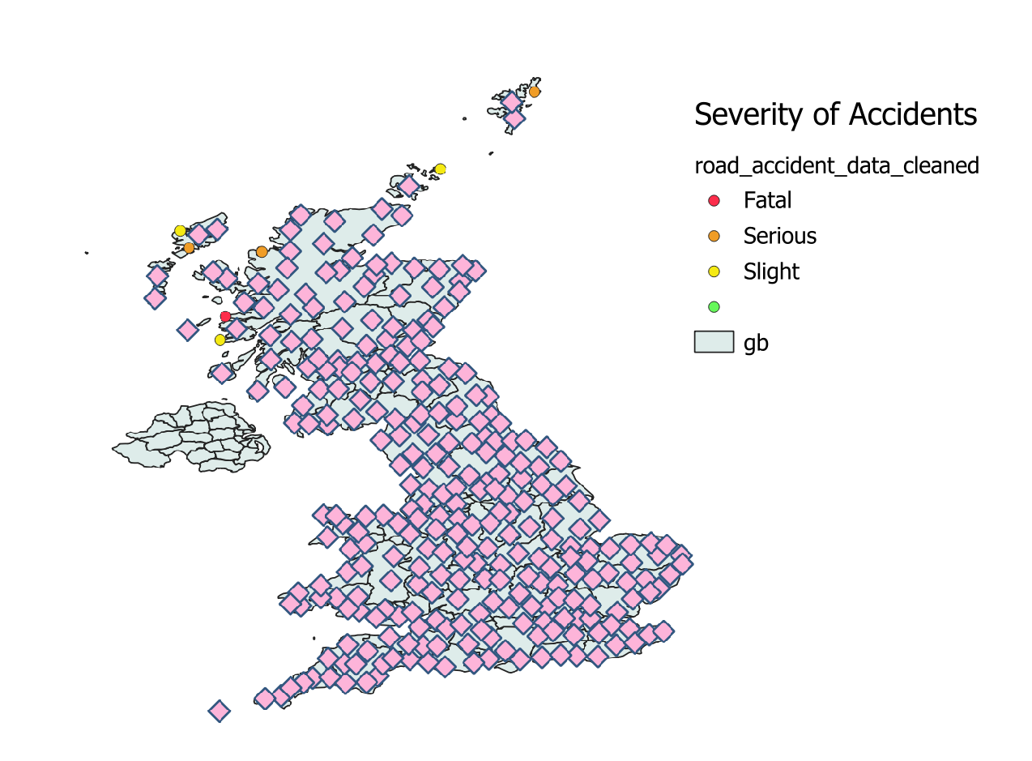
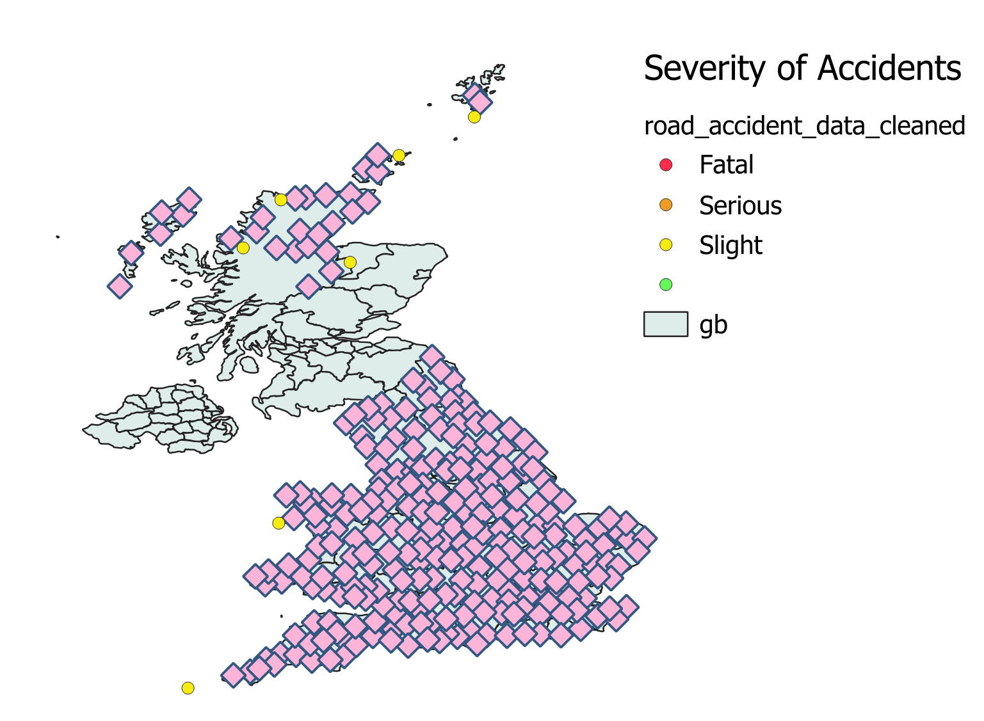
Accident in UK 2021 vs 2022 (Point Cluster)
2021
2022

Slide 9
Accident in UK 2021
A lot of accidents over UK
Most of it occurs in the southern parts
  Higher population in the area as compared to the northern parts

Slide 10
Accident in UK 2022
Some accidents occurred in the northern part of UK
A lot occurring in the southern part of UK → Similar to 2021 with higher population
The middle part of UK has no recorded accidents.

Slide 11
Conclusion
Over time the number of traffic accidents in UK from 2021 – 2022 has decreased which could be due to many reasons
Factors like population, area type, and time can affect the risk of traffic accidents
Some solutions include
  Commuters to be careful during high-risk conditions
    High population
    Rush/Lunch/Peak hour
    Etc.
  Stronger traffic safety regulations

